Slide 1
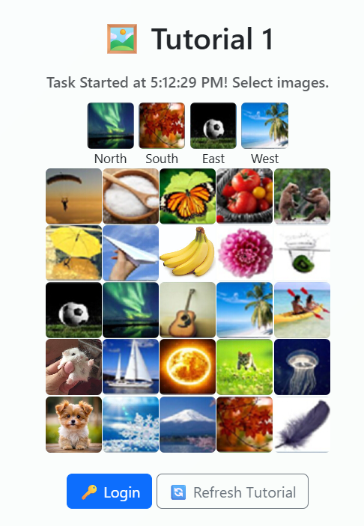


























Registered Password
Registered Direction
You need to use the Registered Password and Registered Direction to find the actual password to login

Slide 2
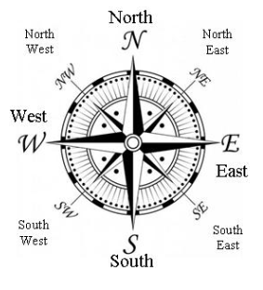
Tutorial 1
We will use :
*PW to represent Actual Password to Click
*RP to represent Registered Password
Tutorial 1 using:
4 Directions Rules – North, South, East, West
Will have Normal Case
Will have Special Case (when *PW is OUT of the grid)

Slide 3

Tutorial 1: Normal Case Example
*PW
Actual Password to Click
*RP
Registered Password
North
South
East
West
*PW
*RP
*RP
*RP
*PW
*PW
*RP
*PW

Slide 4
Tutorial 1: Special Case Example
*PW
Actual Password to Click
*RP
Registered Password
Out of Grid
North
South
East
West
*RP
*PW
Out of Grid
Out of Grid
*PW
*RP
*RP
*PW
*RP
*PW
Out of Grid

Slide 5
Tutorial 1 – Normal Case Example

Slide 6
Tutorial 1: Registered Password & Registered Direction
Registered Password :
Registered Direction :
North
South
East
West

Slide 7
Tutorial 1: Normal Case
First Image
North
South
East
West
When the Registered Direction is North (up). The Actual Password to Click (*PW) is at North (up) of Registered Password (*RP).
*RP

Slide 8
Tutorial 1: Normal Case
First Image
North
South
East
West
*PW
So, the *PW is
*RP

Slide 9
Tutorial 1: Normal Case
Second Image
South
North
East
West
When the Registered Direction is South (bottom). The Actual Password to Click (*PW) is at South (bottom) of Registered Password (*RP).
*RP

Slide 10
Tutorial 1: Normal Case
Second Image
South
North
East
West
So, the *PW is
*RP
*PW

Slide 11
Tutorial 1: Normal Case
Third Image
East
North
South
West
When the Registered Direction is East (right). The Actual Password to Click (*PW) is at East (right) of Registered Password (*RP).
*RP

Slide 12
Tutorial 1: Normal Case
Third Image
East
North
South
West
So, the *PW is
*RP
*PW

Slide 13
Tutorial 1: Normal Case
Forth Image
West
North
South
East
When the Registered Direction is West (left). The Actual Password to Click (*PW) is at West (left) of Registered Password (*RP).
*RP

Slide 14
Tutorial 1: Normal Case
Forth Image
West
North
South
East
So, the *PW is
*PW
*RP

Slide 15
Tutorial 1: Normal Case
Overall
North
South
East
West
Password Need to Click for Successful Login:
*PW1
*PW3
*PW4
*PW2

Slide 16
Out of Grid
Tutorial 1 – Special Case Example
(*PW Out of Grid)
Out of Grid
Out of Grid
Out of Grid

Slide 17
Tutorial 1: Registered Password & Registered Direction
Registered Password :
Registered Direction :
North
South
East
West

Slide 18
Tutorial 1: Special Case
First Image
Out of Grid
North
South
East
West
*RP
When the Registered Direction is North (up). The Actual Password to Click (*PW) is at North (up) of Registered Password (*RP).

Slide 19
Tutorial 1: Special Case
First Image
Out of Grid
North
South
East
West
*RP
However, the Actual Password to Click (*PW) is Out of the Grid. Therefore, need to wrap to opposite side. So, the *PW is
Wrap to opposite side
*PW

Slide 20
Tutorial 1: Special Case
Second Image
South
North
East
West
When the Registered Direction is South (bottom). The Actual Password to Click (*PW) is at South (bottom) of Registered Password (*RP).
*RP
Out of Grid

Slide 21
Tutorial 1: Special Case
Second Image
South
North
East
West
*PW
However, the Actual Password to Click (*PW) is Out of the Grid. Therefore, need to wrap to opposite side. So, the *PW is
Wrap to opposite side
*RP
Out of Grid

Slide 22
Tutorial 1: Special Case
Third Image
East
North
South
West
Out of Grid
When the Registered Direction is East (right). The Actual Password to Click (*PW) is at East (right) of Registered Password (*RP).
*RP

Slide 23
Tutorial 1: Special Case
Third Image
East
North
South
West
Wrap to opposite side
Out of Grid
However, the Actual Password to Click (*PW) is Out of the Grid. Therefore, need to wrap to opposite side. So, the *PW is
*PW
*RP

Slide 24
Tutorial 1: Special Case
Forth Image
West
North
South
East
When the Registered Direction is West (left). The Actual Password to Click (*PW) is at West (left) of Registered Password (*RP).
Out of Grid
*RP

Slide 25
Tutorial 1: Special Case
Forth Image
West
North
South
East
However, the Actual Password to Click (*PW) is Out of the Grid. Therefore, need to wrap to opposite side. So, the *PW is
Out of Grid
*RP
*PW
Wrap to opposite side

Slide 26
Tutorial 1: Special Case
Overall
North
South
East
West
*PW2
Password Need to Click for Successful Login:
*PW3
*PW4
*PW1

